Slide 1
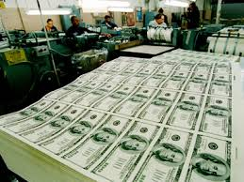
BANKING PROCESS
BY
K. Prathyusha – 1602-14-737-094
V. Vineela Reddy – 1602-14-737-119

Slide 2
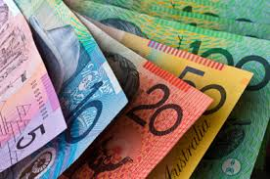
INTRODUCTION
In this century our world clock runs mainly based on a primary thing i. e. 'Money'.
It is the primary thing
in every human life.
But this money is operated
for our needs in a systematic way i. e.
through banks.

Slide 3
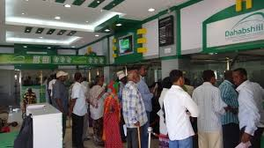
And the process through
which money operates,
“Banking Process”.
Generally we give more priority for general banking by visiting banks.
But the thing many people can't realize is, we are wasting our valuable time.

Slide 4

OUR IDEA
Why cant we make
our work much easier
by this type of
banking
process?

Slide 5
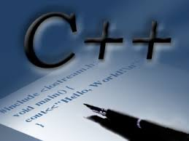
SOFTWARE' S USED
C++
Data Structures

Slide 6

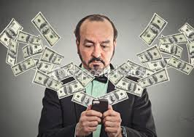
CONCLUSION
Our aim is to make our
life easier and
comfortable by
net banking process.

Slide 7
Queries?

Slide 8
THANK YOU

